Slide 1
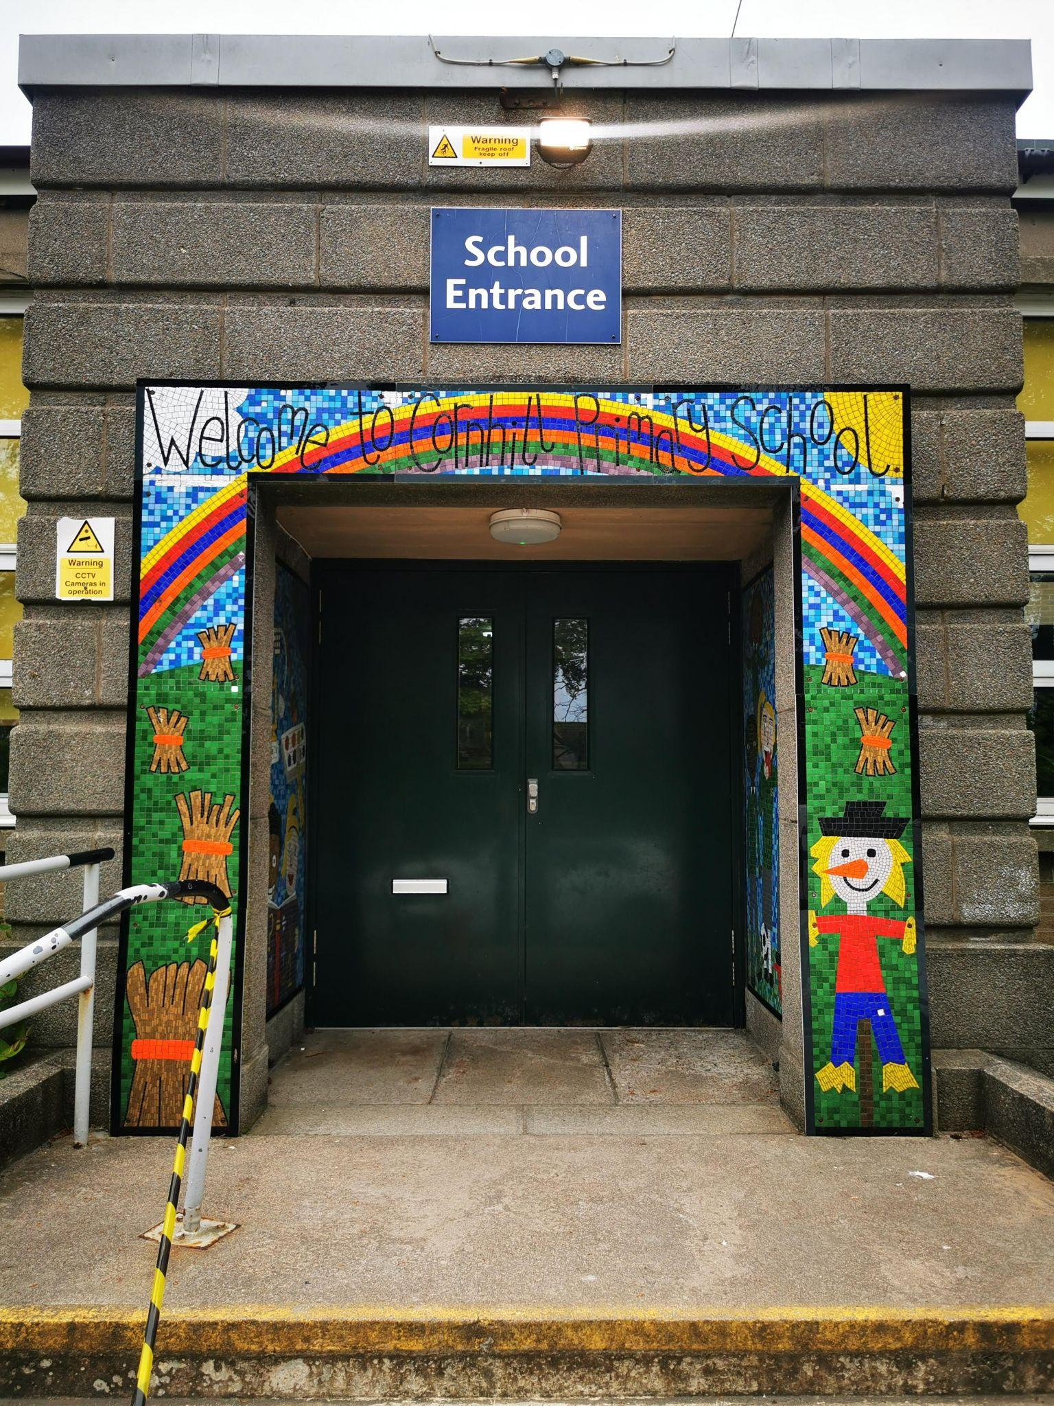
Cornhill Primary School
Primary 1 Induction Meeting
Friday 31st May 2024 – 2.15 pm

Slide 2
The child’s first school is a very important place to him/her. We consider ourselves to be a caring school and value your child as an individual.
We recognise the fact that your child has already learned many things and that he/she will bring many experiences to school, and we look forward to working in partnership with you to further your child’s education.
Welcome

Slide 3
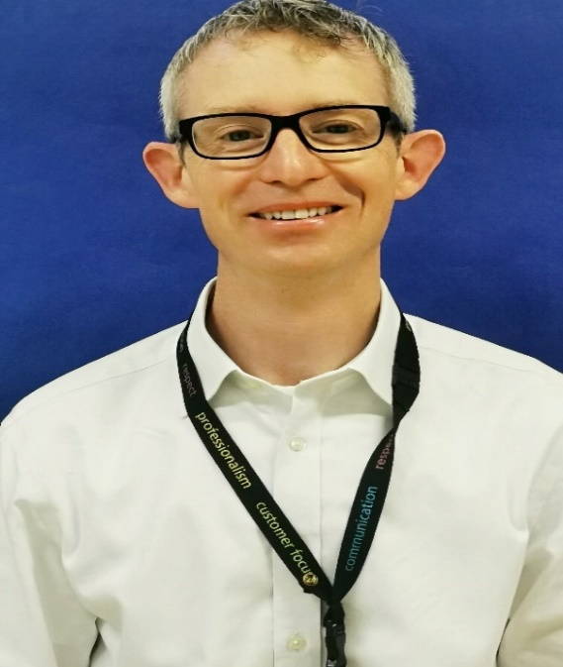
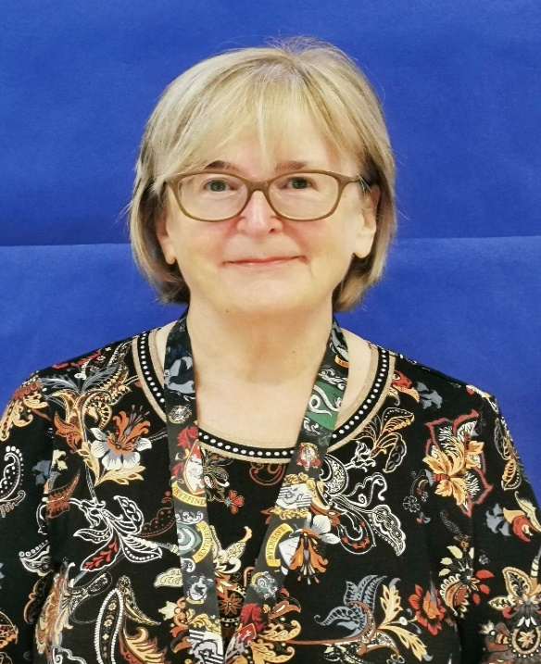
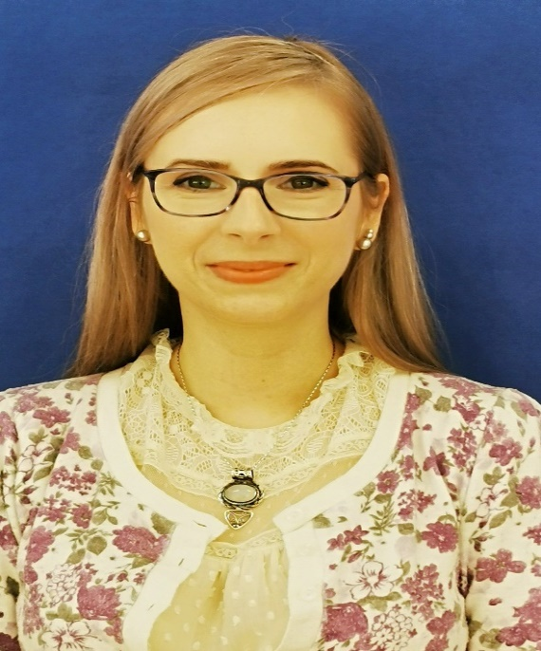
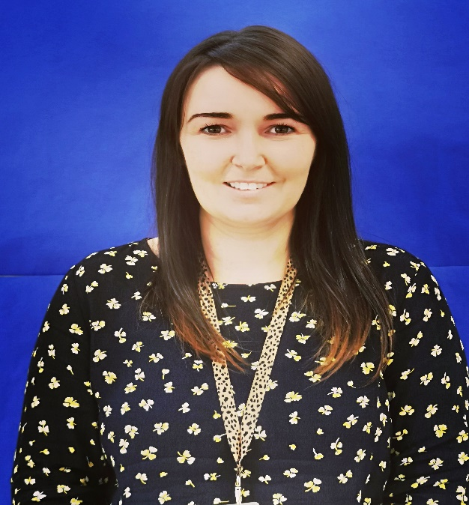
Mr Evans
The Headteacher
Mrs Morgan
DHT Early Years
Mrs Krakowska
DHT Early Years
Miss Devlin
Principal Teacher Early Years
Meet the School Team

Slide 4
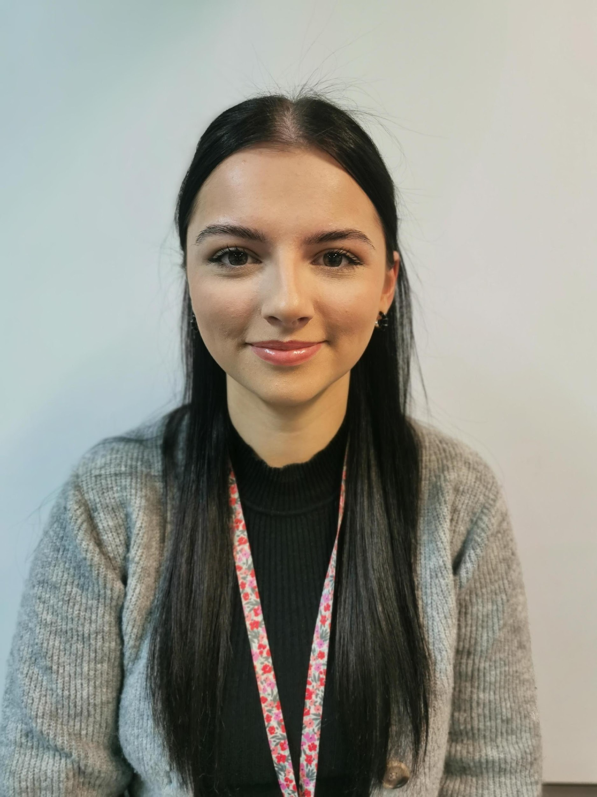
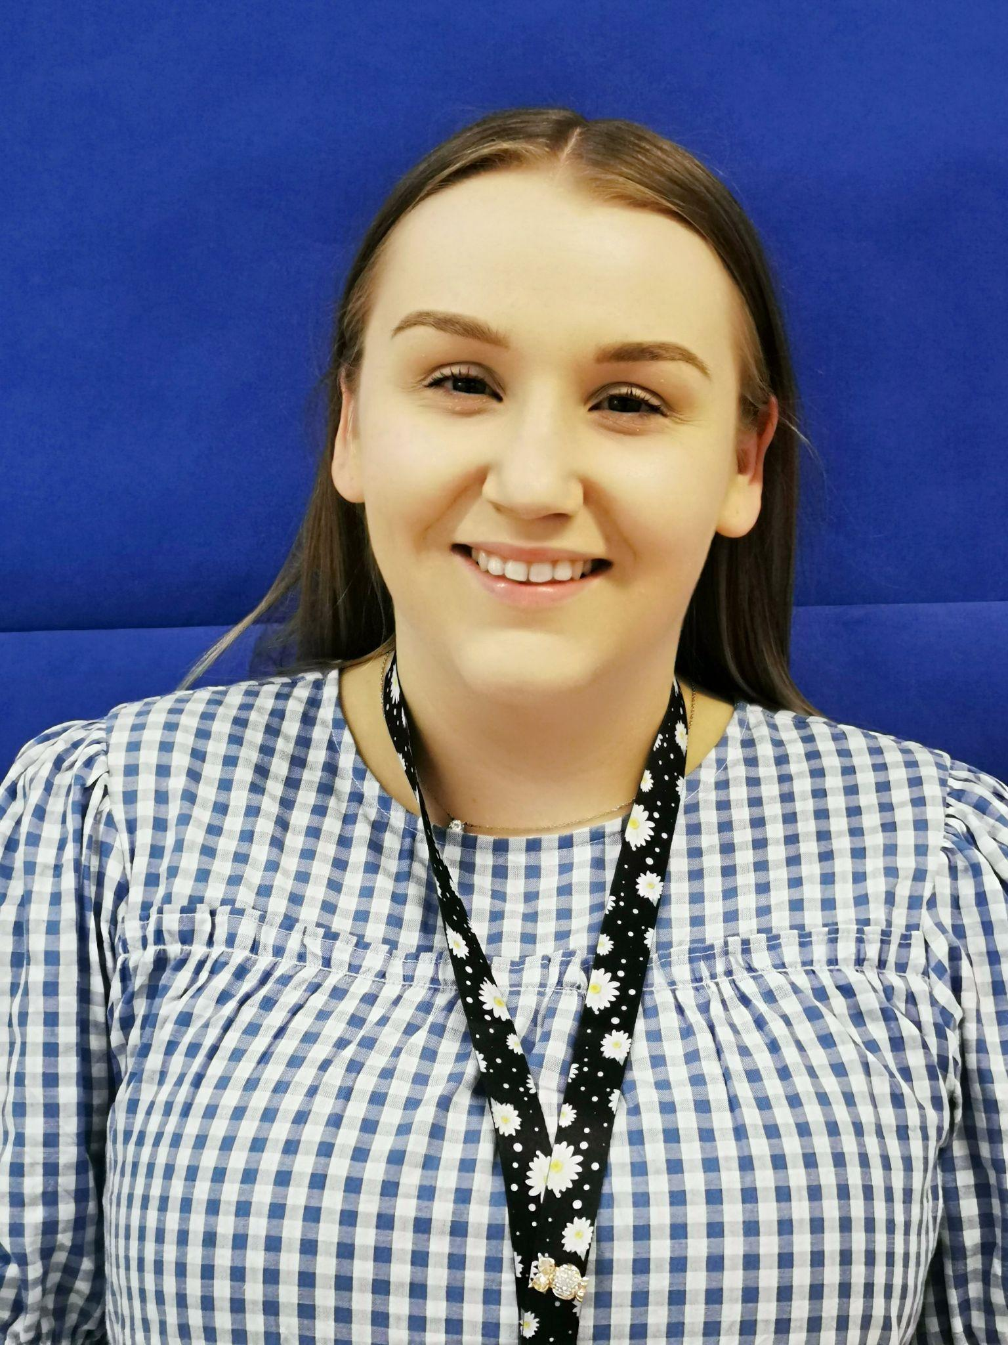
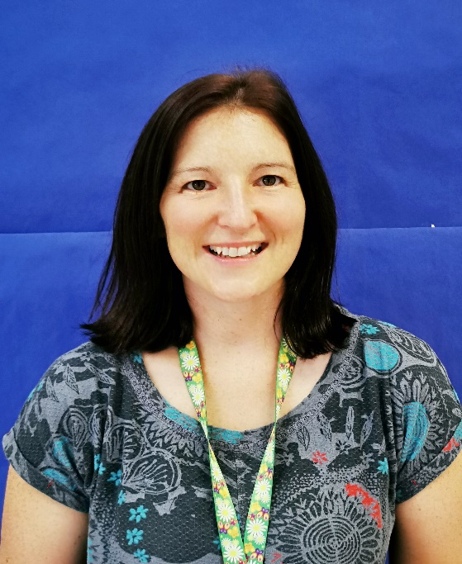
Miss Dunbar
Primary 1 Room 3
Miss Rennie
Primary 1 Room 4
Mrs Young
Primary 1/2 Room 5
Meet the Class Teachers

Slide 5
Play-Based Learning
Our Learning in Primary 1

Slide 6
Composite Classes
There is no specific reason why your child is in a composite class. When there aren’t enough or are too many children in a year group to make up full classes, we have a composite class.
Composite classes have a mixture of pupils from 2 different year groups.

Slide 7
Children will have a morning with their teacher in a small group on either Tuesday, Wednesday or Thursday of the first week so they can get to know your child in their new classroom. You have received an email stating your child’s First Day (Induction) – Please respond to email if you haven’t already. Group 1 - Tuesday, 20th August, Group 2 - Wednesday, 21st August or Group 3 – Thursday, 22nd August. On the induction day, your child should line up outside the P1 doors with their classmates. This will be marked with a cone. For this day, please bring your child at 9.15 am so we can let you drop off older siblings and can clear the playground of other pupils. You may come into the class with your child for the first induction day only and are welcome to take pictures of YOUR child and their classroom. Children will be brought outside to you at the gate at 12.00 pm. An adult will remain with them until a guardian collects them. Please be punctual.
Induction Day

Slide 8
Then on Friday 23rd August all children will be together for the morning. Week beginning Monday 26th August all children come for mornings only. 9.15 am – 12 pm Primary One pupils should line up at their classroom number (3, 4 or 5). We ask you to remain outside the building and wave goodbye to your child from there. Children will be brought outside to you in the playground at 12.00pm.
Half Days

Slide 9
Week beginning Monday 2nd September children attend for full days, 9 am – 3 pm Primary One pupils should line up at their classroom number (3, 4 or 5) at 9 am. Children will be brought out at 3 pm. We ask you to come forward and wave to your child to help the teacher, so it’s easier for us to ensure each child is collected by the correct adult. If there is a different adult picking up a child, please inform the teacher in the morning.
Full Days

Slide 10
Attendance is compulsory in Primary One. Please ensure your child attends regularly and is on time. Lateness is recorded in the sign-in book at the Main Office. You must inform the office (8.30 am onwards) if your child is unwell or will be absent for any reason. Sickness and diarrhoea (48 hrs from the last episode) If we cannot contact you, we might ask Home-School Liaison Officer to contact you in line with our Child Protection Policy.
Attendance

Slide 11
School Hours – 9 am to 3 pm 9 am – 10.30 am Learning Time 10.30 am – 10.45 am Snack Time / Playtime 10.45 am – from 12 onwards Learning time Lunch Time (45m) – Staggered Lunches (school lunch or packed lunch) – Lunch menu / Parent Pay After Lunch – 3 pm Learning Time
Speaking to a staff member
Healthy Snack / Bottle of water / Lunchtime supervision
Important Information
And things to remember about ☺

Slide 12
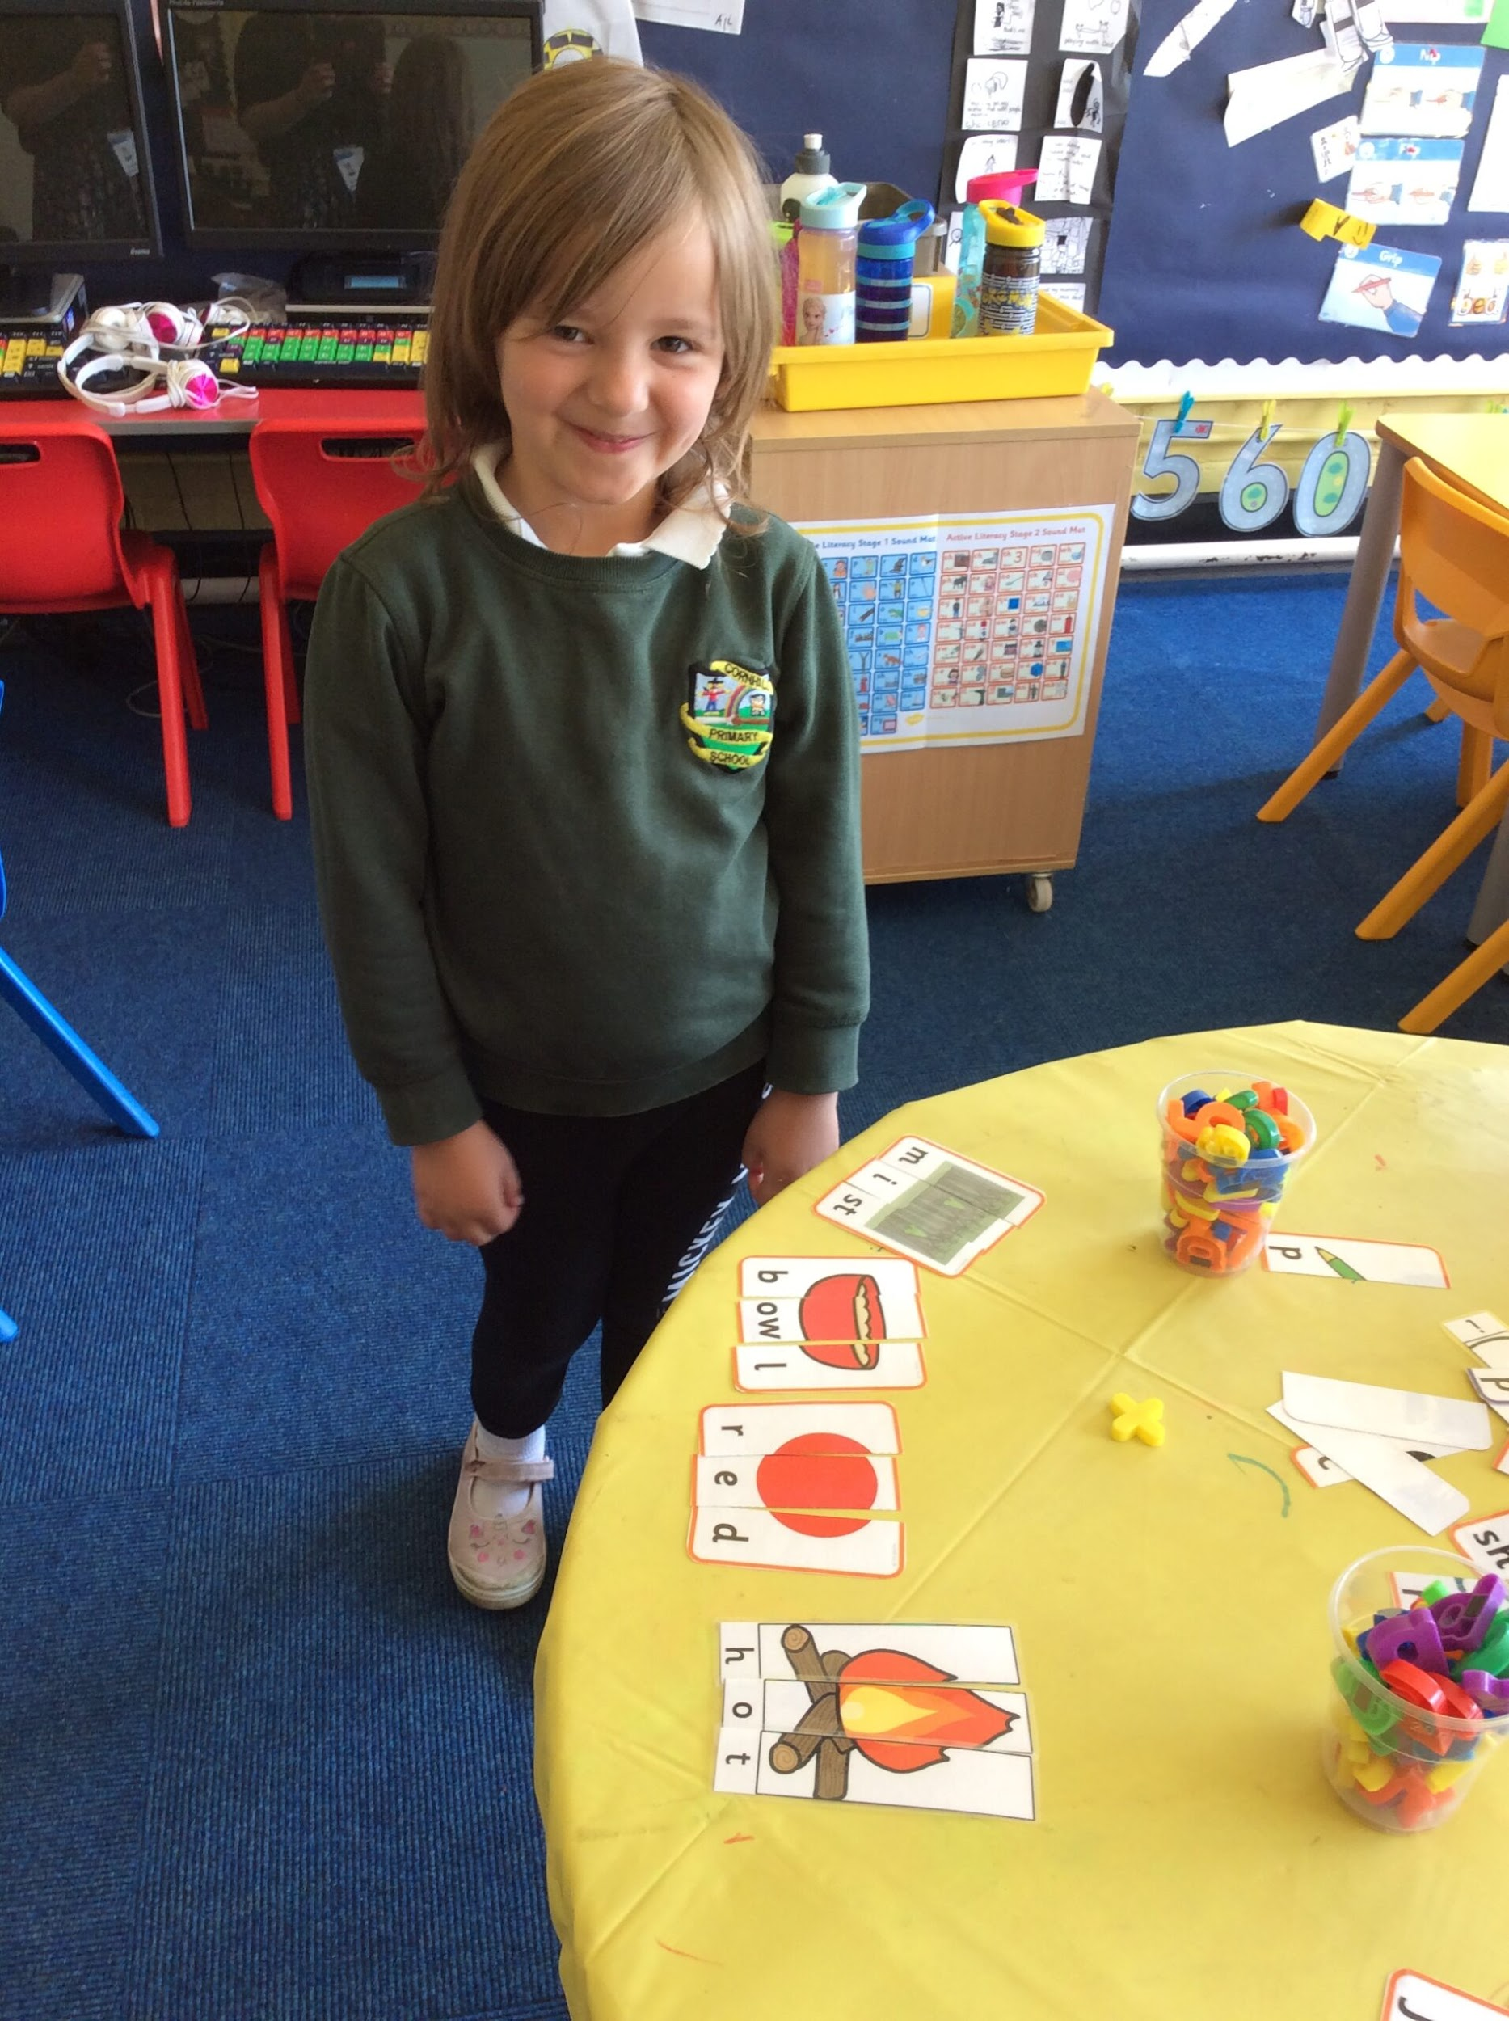
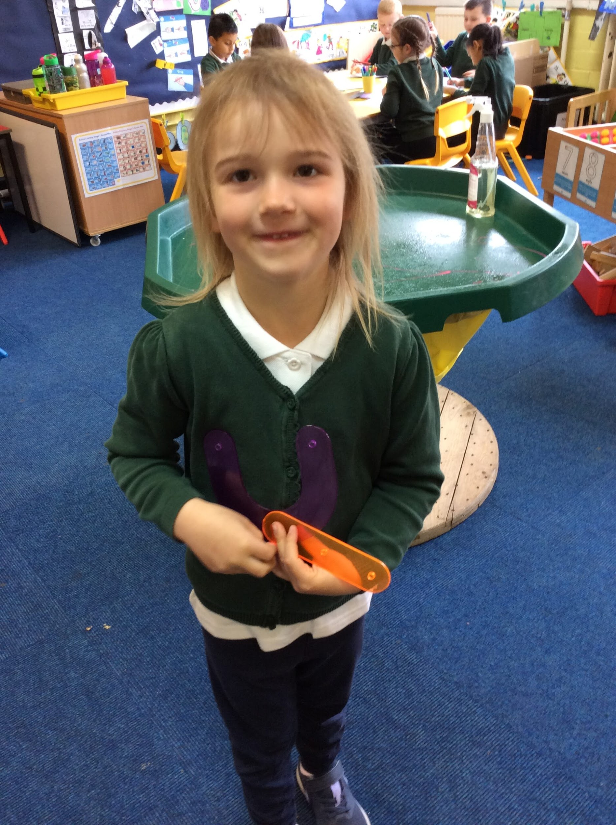
You can order the school uniform for your child from www.myclothing.com * Dark trousers / Skirt / Pinafore * White Polo t-shirt * School jumper / Cardigan * Comfortable shoes (make sure your child has a change of shoes for cold, wet weather.
School Uniform

Slide 13
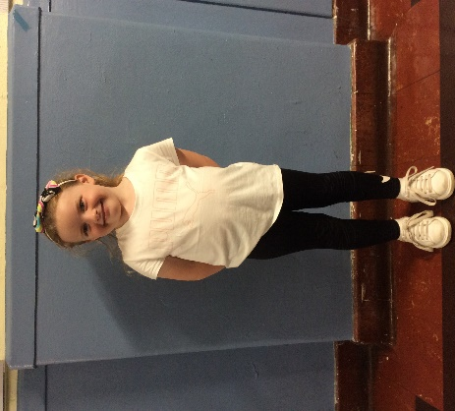
* Long hair tied back
* Comfortable trainers
* No vests or crop tops
* No football kits/jeans
No jewellery (inc. earrings)
School jumper on the top
PE / RADS Kit

Slide 14
Professional Services
School Doctor
School Nurse – parental support with health issues including eating, toileting and headlice.
Dentist and Childsmile - daily toothbrushing.
Educational Psychologist – learning difficulties, behavioural etc.
Speech and Language Therapists – may already be involved or on the waiting list from the nursery – speech development
These services can be accessed through discussion with a member of SMT, if required.
Medication in school – administration form to be filled in at the reception office. All medication must be clearly labelled and be prescribed by a doctor or a pharmacist.

Slide 15
What can you do to help?
Dress/Undress – shoes, coat, school bag etc.
Label belongings – children are taught to take responsibility for their items
Cutlery – practise using cutlery at home with your child
Possessions/Toys – please keep them at home as they might get damaged or misplaced
Toilet
Play / Share / Take Turns

Slide 16
FAQ
When will my child get a reading book?
How do I get in touch with a teacher?
How about homework?
Are school lunches free? (You can order lunches from home)
Will my child brush their teeth in school?
Does my child need a spare change of clothes?
How can I be more involved? (Parent Council)

Slide 17
Thank you
We look forward to seeing you and your child in August!
Any Questions?

