Slide 1
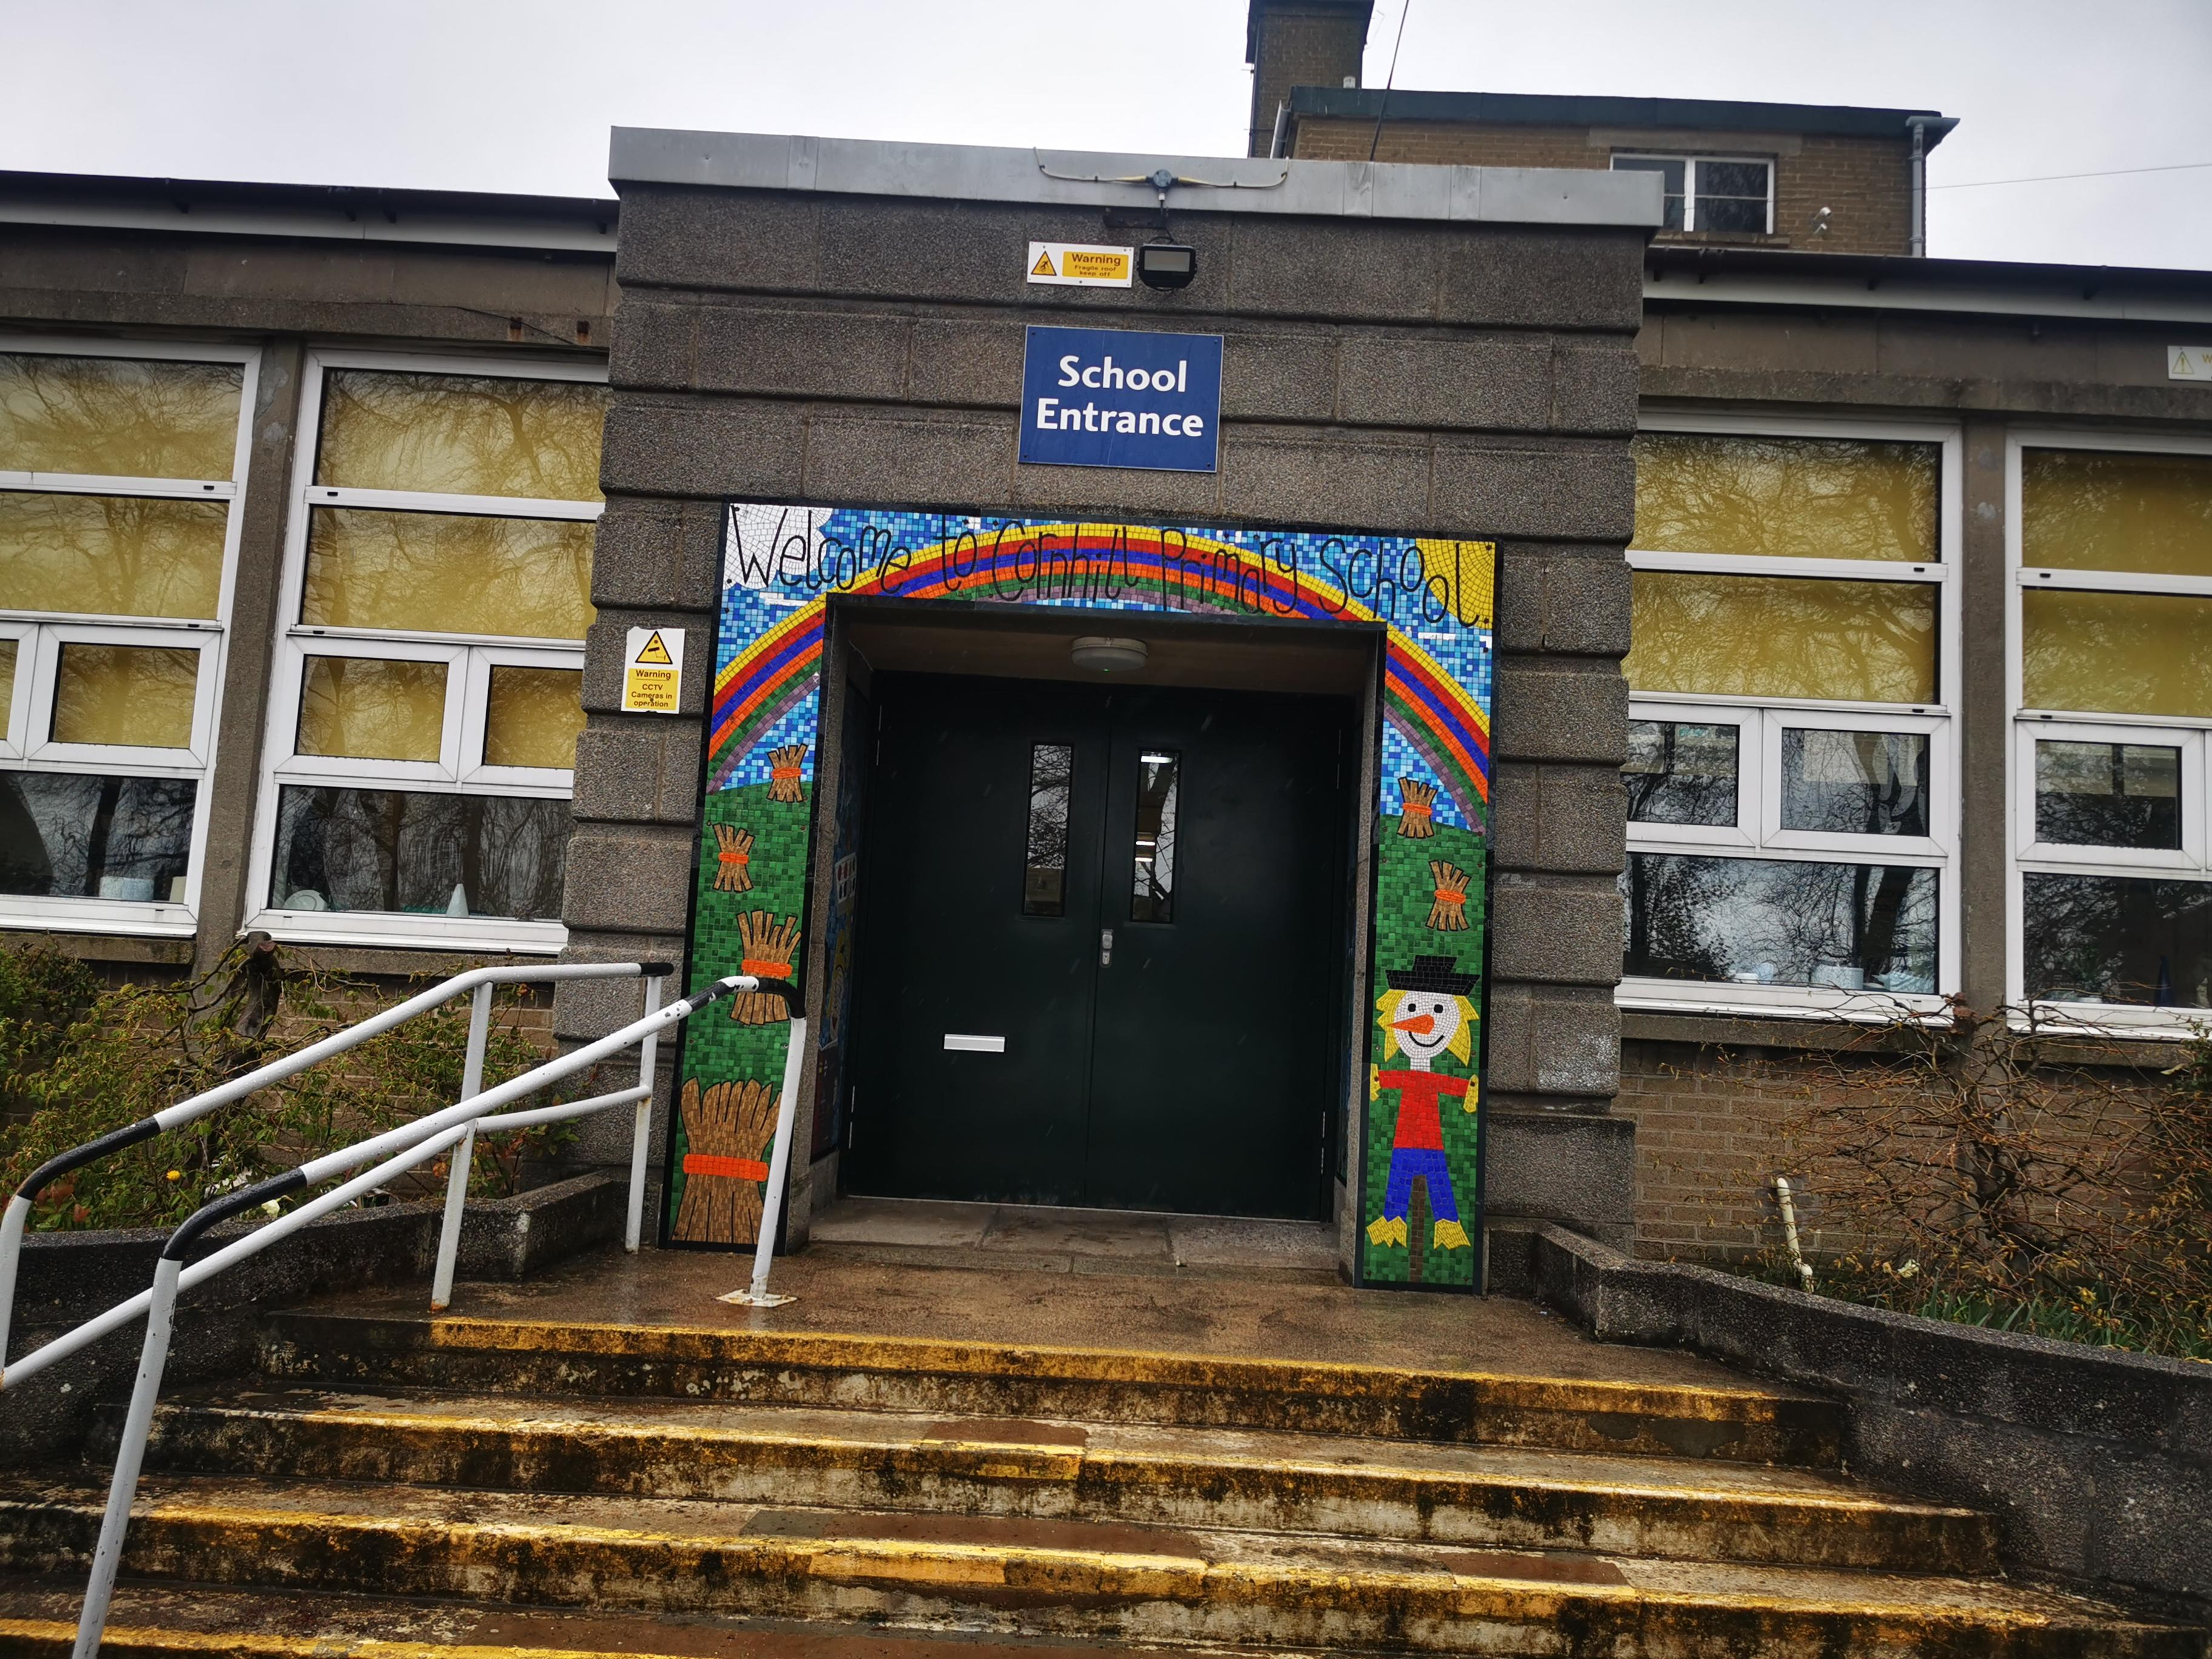
Cornhill Primary School
Primary 1 Induction Meeting
Friday 2nd June 2023 – 1.45 pm

Slide 2
The child’s first school is a very important place to him/her. We consider ourselves to be a caring school and value your child as an individual.
We recognise the fact that your child has already learned many things and that he/she will bring many experiences to school, and we look forward to working in partnership with you to further your child’s education.
Welcome

Slide 3
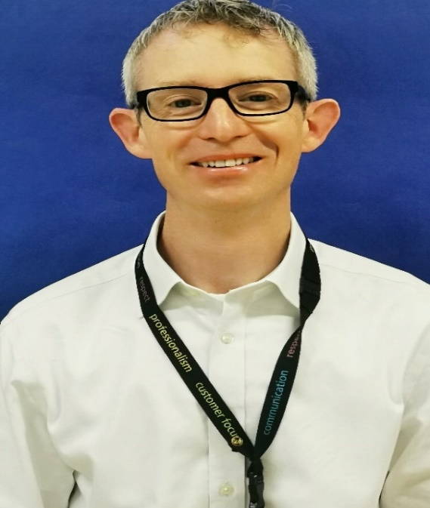
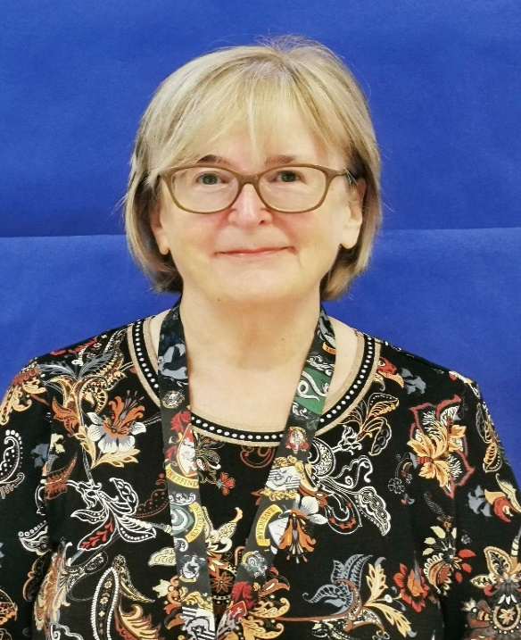
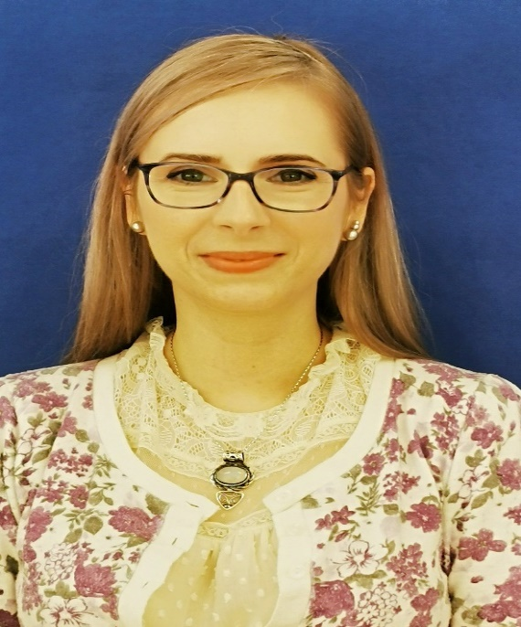
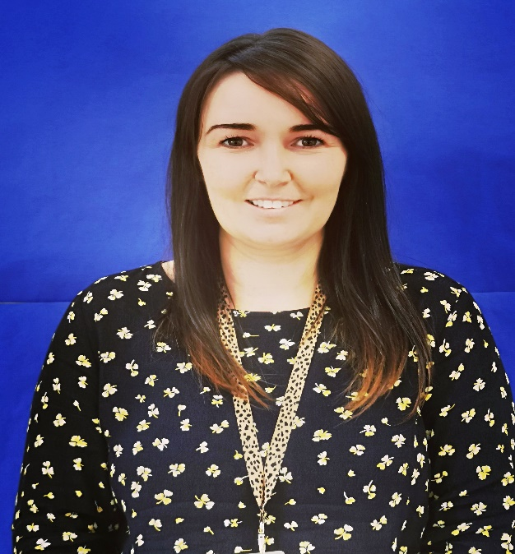
Mr Evans
The Headteacher
Mrs Morgan
DHT Early Years
Mrs Krakowska
DHT Early Years
Miss Devlin
Principal Teacher Early Years
Meet the School Team

Slide 4
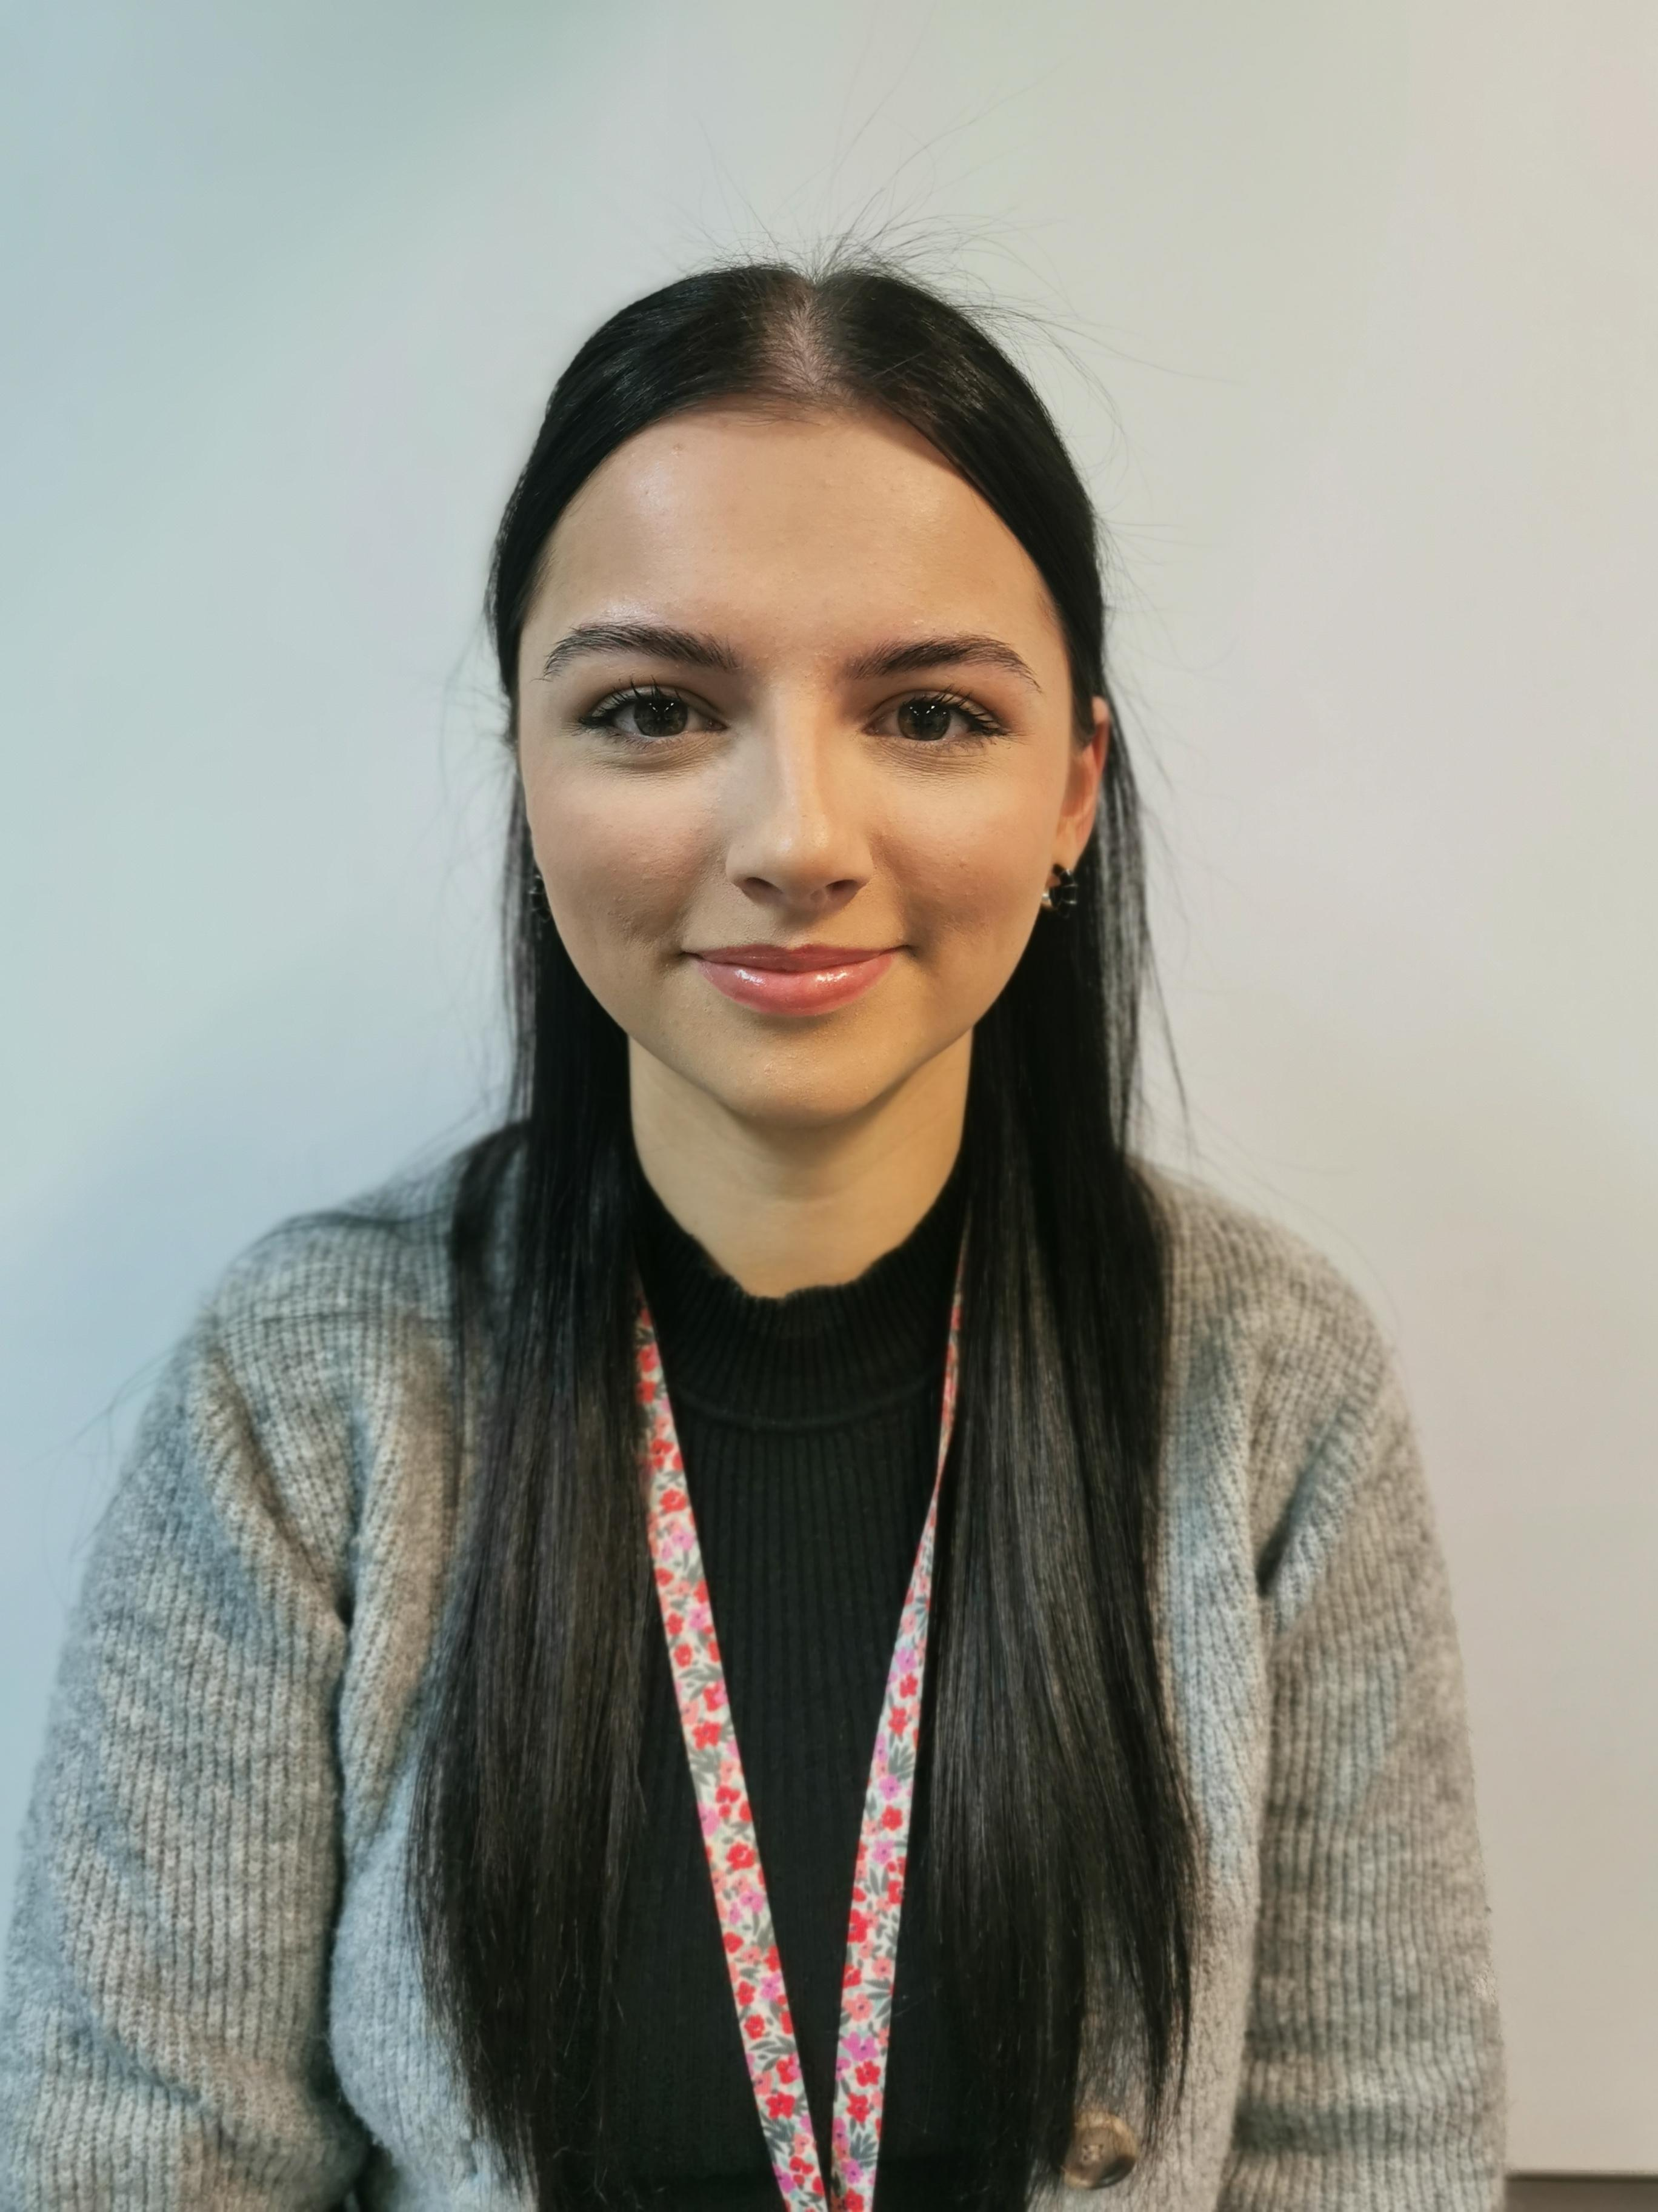
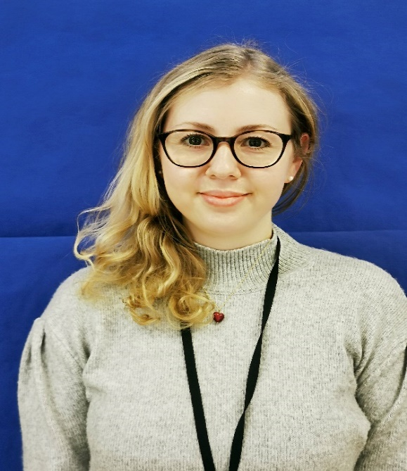
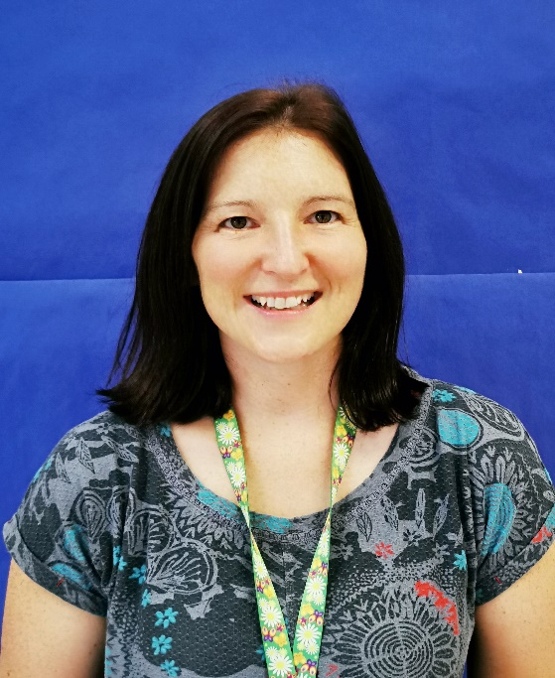
Miss Dunbar
Primary 1 Room 3
Miss Steel
Primary 1 Room 4
Mrs Young
Primary 1/2 Room 5
Meet the Class Teachers

Slide 5
Agenda
Introductions – Meet the staff
Play-Based Learning
Composite Classes
Induction Day, Half Days & Full Days
Attendance
Important Information
School Uniform
Home-School Communication
Professional Services
What can you do to help?
Frequently Asked Questions.
AOB / Any Questions?
Thank you All for coming
A

Slide 6
Play-Based Learning
Our Learning in Primary 1

Slide 7
Composite Classes
All classes will see some variability in the abilities of their students - teaching a composite class is just the same! There is no specific reason why your child is in a composite class. When there aren’t enough or are too many children in a year group to make up full classes, we are obliged to make up composite classes.
Composite classes are a way to spread pupils more evenly between teachers. The composite classes have a mixture of pupils from 2 different year groups.

Slide 8
You have received an email stating your child’s First Day (Induction) – Please respond to email if you haven’t already. Group 1 - Tuesday, 22nd August, Group 2 - Wednesday, 23rd August or Group 3 – Thursday, 24th August. On the induction day, your child should line up outside the P1 doors with their classmates. This will be marked with a cone. For this day, please bring your child at 9.15 am so we can let you drop off older siblings and can clear the playground of other pupils. You may come into the class with your child for the first induction day only and are welcome to take pictures of YOUR child and their classroom. Children will be brought outside to you at the gate at 12.00 pm. An adult will remain with them until a guardian collects them. Please be punctual.
Induction Day

Slide 9
Friday 25th August and the week beginning Monday 28th August 9.15 am – 12 pm Primary One pupils should line up at their classroom number (3, 4 or 5). The spot will also be marked with the cone. We ask you to remain outside the building and wave goodbye to your child from there. Children will be brought outside to you at the gate at 12.00pm. An adult will remain with them until a guardian collects them. Please be punctual.
Half Days

Slide 10
Week beginning Monday 4th September 9 am – 3 pm Primary One pupils should line up at their classroom number (3, 4 or 5) at 9 am. We ask you to remain outside the school gate and wave goodbye to your child from there unless your child needs support to line up at their room number. Children will be brought to you at the gate at 3 pm. An adult will remain with them until a guardian collects them. Please be punctual. We also ask you to come forward and wave to the teacher so it’s easier for us to ensure there is an adult collecting a child. If there is a different adult picking up a child, please inform the school in the morning.
Full Days

Slide 11
Attendance is compulsory in Primary One. Please ensure your child attends regularly and is on time. Lateness is recorded in the sign-in book at the Main Office. You must inform the office (8.30 am onwards) if your child is unwell or will be absent for any reason. Sickness and diarrhoea (48 hrs from the last episode) If we cannot contact you, we might ask Home-School Liaison Officer to contact you in line with our Child Protection Policy.
Attendance

Slide 12
School Hours – 9 am to 3 pm 9 am – 10.30 am Learning Time 10.30 am – 10.45 am Snack Time / Playtime 10.45 am – from 12 onwards Learning time Lunch Time (45m) – Staggered Lunches (school lunch or packed lunch) – Lunch menu / Parent Pay After Lunch – 3 pm Learning Time
Breakfast Club and After School Club
RADS-Russell Anderson Development School
Assembly
Buddies / Prefects / Helpers
Speaking to a staff member
Healthy Snack / Bottle of water / Lunchtime supervision
Important Information
And things to remember about ☺

Slide 13
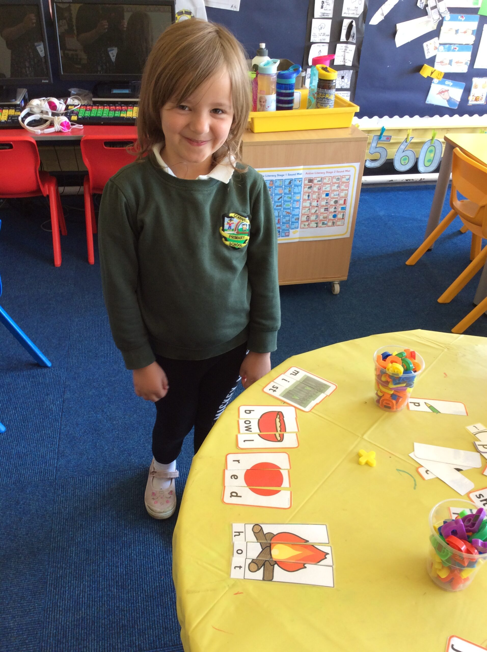
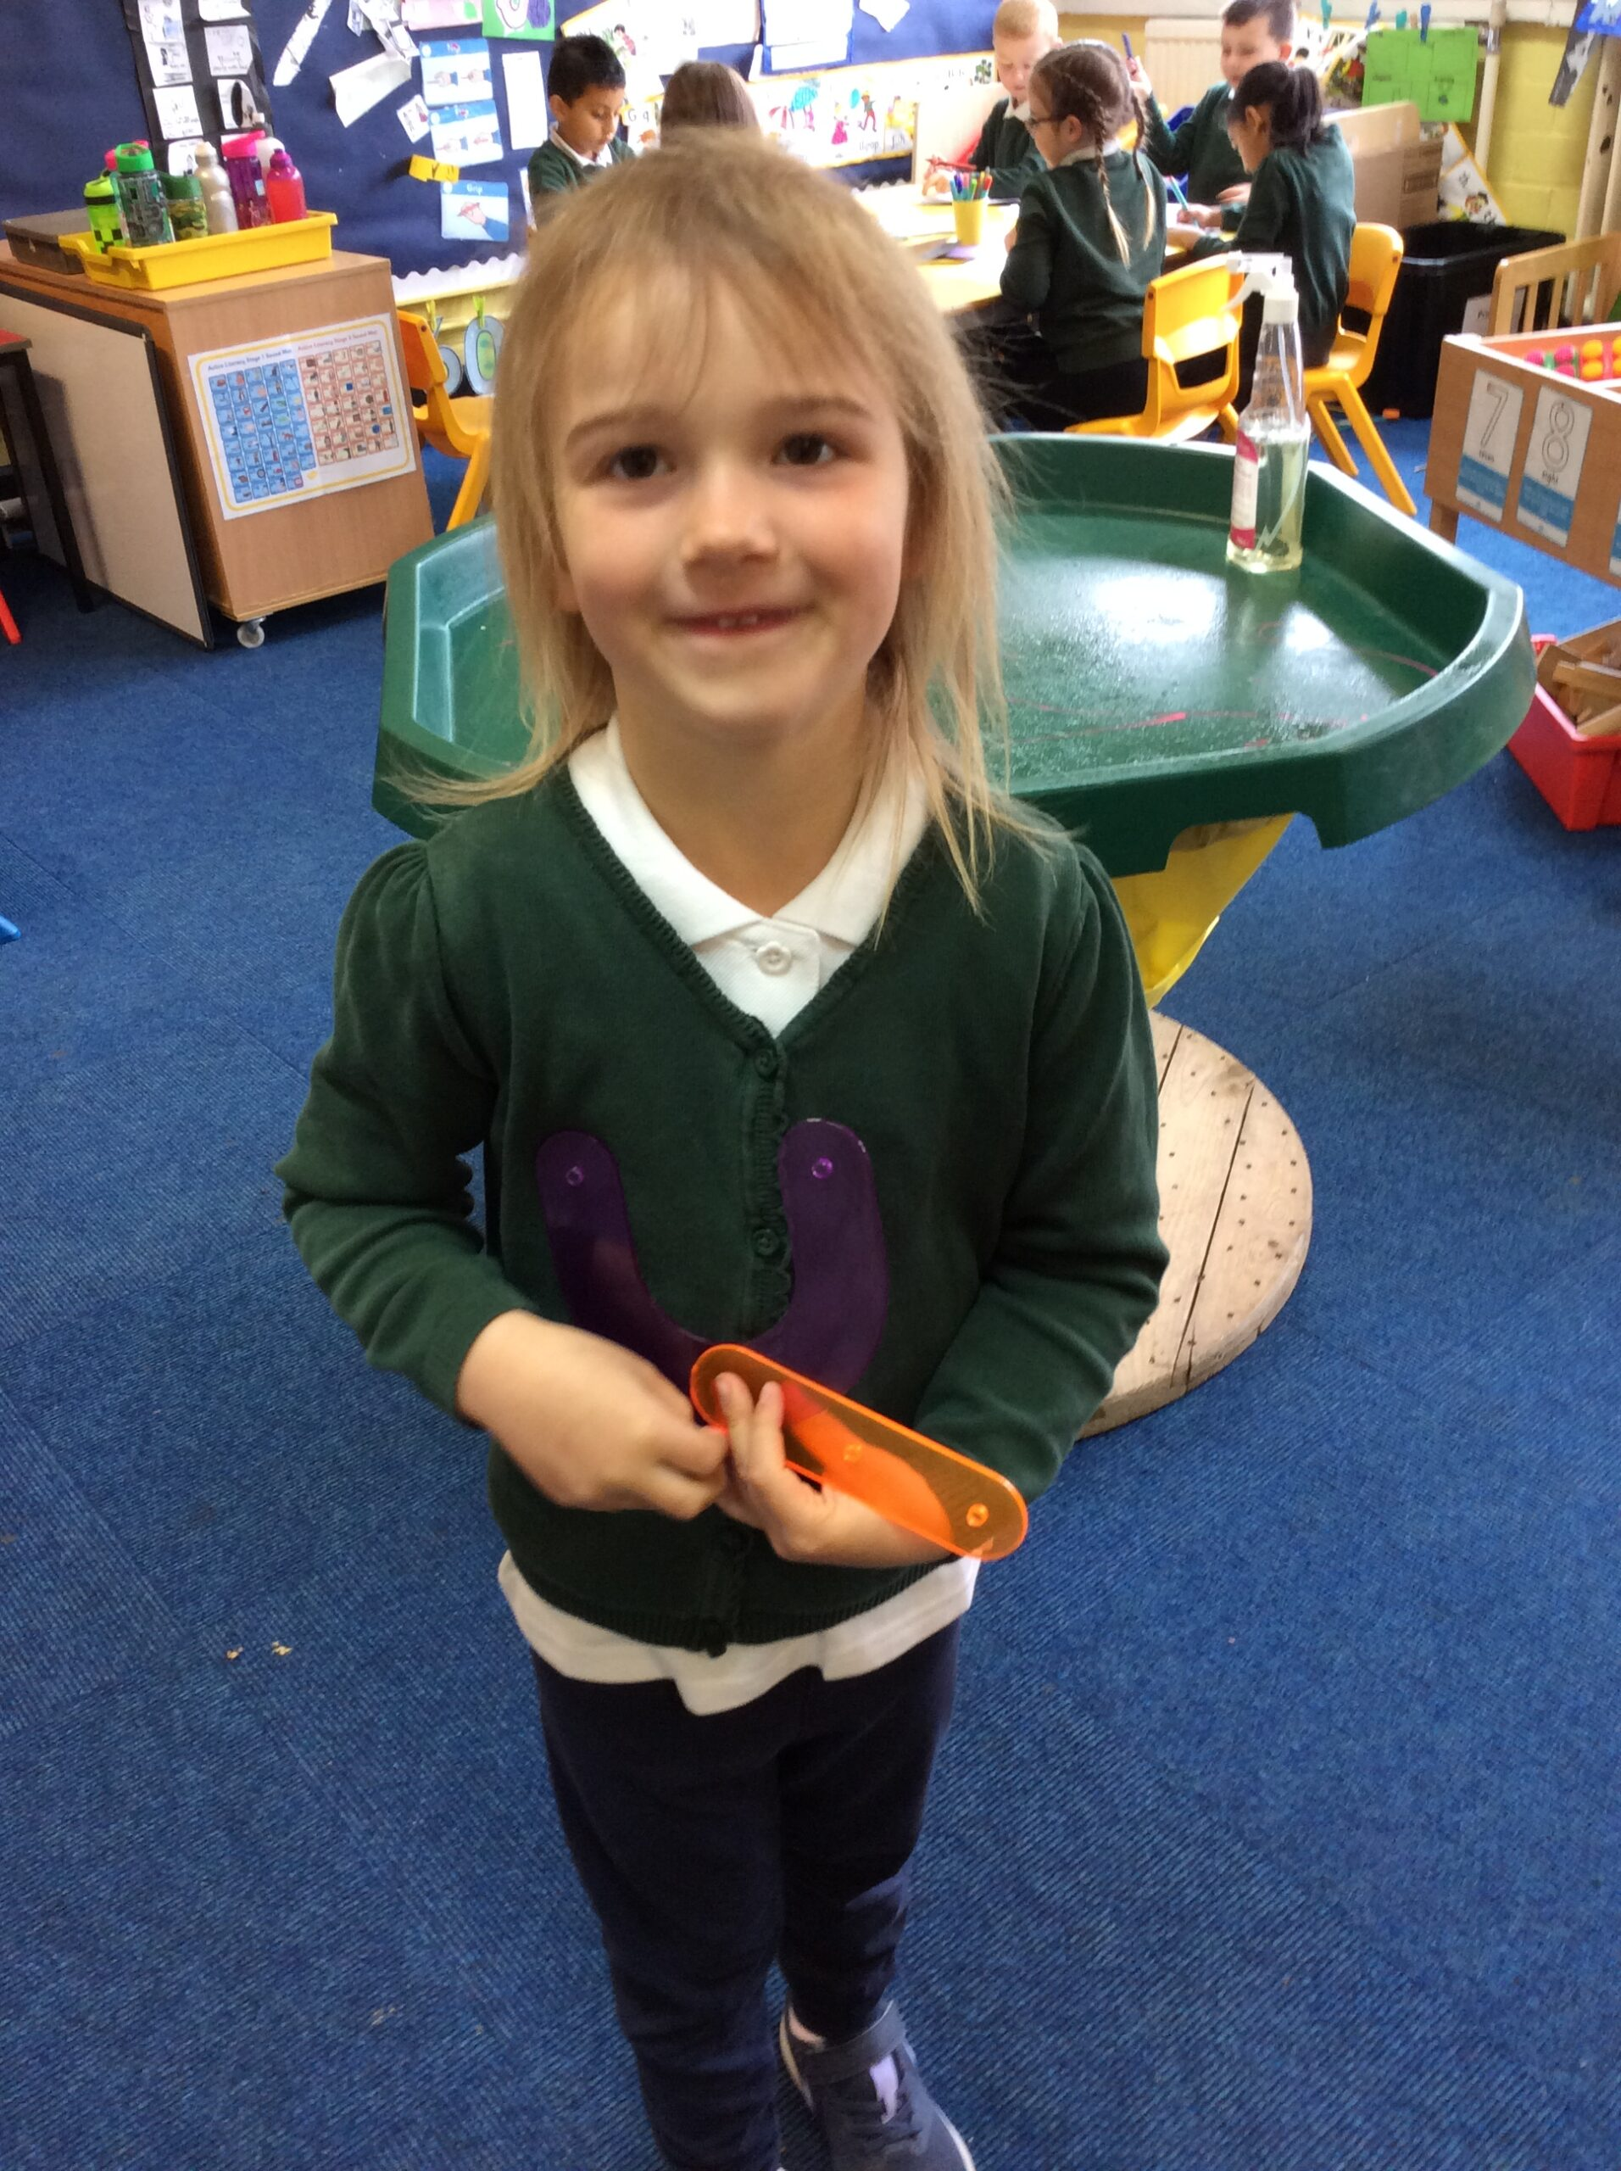
You can order the school uniform for your child from www.myclothing.com * Dark trousers / Skirt / Pinafore * White Polo t-shirt * School jumper / Cardigan * Comfortable shoes (make sure your child has a change of shoes for cold, wet weather.
School Uniform

Slide 14
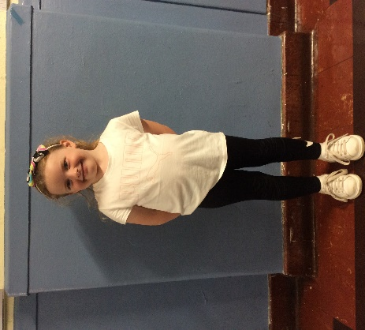
* Long hair tied back
* Comfortable trainers
* No vests or crop tops
* No football kits/jeans
No jewellery (inc. earrings)
School jumper on the top
PE / RADS Kit

Slide 15
Home-School Communication/Information
Seesaw / Google Classroom
Homework
Class information
Notifications of Events
Sharing Learning
Communication with teachers/parents
Newsletters
Upcoming Events
Sharing Learning
Notifications
Communication with parents
Email the teacher/school
Phone the school directly
Meet the teacher/SMT after school
Arrange a meeting
School Website
Primary 1 information

Slide 16
Professional Services
School Doctor
School Nurse – parental support with health issues including eating, toileting and headlice.
Dentist and Childsmile - daily toothbrushing.
Educational Psychologist – learning difficulties, behavioural etc.
Speech and Language Therapists – may already be involved or on the waiting list from the nursery – speech development
These services can be accessed through discussion with a member of SMT, if required.
Medication in school – administration form to be filled in at the reception office. All medication must be clearly labelled and be prescribed by a doctor or a pharmacist.

Slide 17
What can you do to help?
Dress/Undress – shoes, coat, school bag etc.
Label belongings – children are taught to take responsibility for their items
Cutlery – practise using cutlery at home with your child
Possessions/Toys – please keep them at home as they might get damaged or misplaced
Toilet
Play / Share / Take Turns
At the end of the session, please help yourselves with a leaflet of things you can do and practise with your child over the summer holidays.

Slide 18
FAQ
When will my child get a reading book?
How do I get in touch with a teacher?
How about the homework?
Are school lunches free? (You can order lunches from home)
Will my child brush their teeth in school?
Does my child need a spare change of clothes?
How can I be more involved? (Parent Council)

Slide 19
Thank you
We look forward to seeing you and your child in August!
Any Questions?

Slide 20
Reminders for children NOT currently in Cornhill Nursery
For Parents & Carers and children not currently at Cornhill Nursery:
An opportunity to see round the school on Monday 12th June at 3.15pm. Please come to the school office front door and we will show you the classrooms, gym hall, playground etc.
For Parents & Carers and children not currently at Cornhill Nursery AND children and Parents/Carers of Cornhill Nursery 3 pm children:
An opportunity to sample a school lunch on Monday 19th June at 11.15. Please come to the school office front door and we will take you to the lunch hall.

